Slide 1
Suganth.G (2021506111) Crop Recommendation.

Slide 2
Agenda
Introduction
The Role of soil minerals
Environmental variables
Problem Statement
Technologies used
Future enhancements
Demo

Slide 3
Crop Recommendation system

Slide 4
Introduction
In the realm of agriculture, where traditional knowledge meets cutting-edge technology, the Crop Recommendation System is revolutionizing how farmers choose crops. By taking into account the mineral composition of the soil, including potassium, nitrogen, and phosphorous, as well as factors like humidity, temperature, and rainfall, this data-driven project is empowering farmers with precise recommendations

Slide 5
Role of soil minerals
Potassium: Potassium is a vital nutrient for plant growth, contributing to root development, disease resistance, and overall plant health. Soil tests reveal potassium levels, helping the system suggest crops that thrive in either high or low potassium conditions.
Nitrogen: Nitrogen is essential for chlorophyll production and overall plant growth. Soil nitrogen content influences crop recommendations, as different crops have varying nitrogen requirements.
Phosphorous: Phosphorous is crucial for root development and flowering. Soil phosphorous levels guide the system in suggesting crops that can optimize the available phosphorous.

Slide 6
Environmental variables
Humidity: Crop success is closely tied to humidity levels. High humidity can lead to moisture-related diseases, while low humidity can result in stress for certain crops. The Crop Recommendation System factors in local humidity conditions to make precise recommendations.
Temperature: Temperature affects the rate of plant growth and flowering. Some crops thrive in cooler conditions, while others prefer warmer climates. The system considers local temperature data for tailored suggestions.
Rainfall: Rainfall during the growing season is essential for crop success. The Crop Recommendation System accounts for historical rainfall patterns and monsoon data to provide recommendations that align with local water availability.

Slide 7
Problem statement
Develop a machine learning-based crop recommendation system that takes into account factors such as soil quality, climate conditions, and historical crop yield data to recommend the most suitable crops for farmers. The system should be able to provide accurate recommendations that can help maximize crop yield and profitability for farmers while considering sustainability and environmental factors.

Slide 8
Technologies used
Python: Programming language used for model development, data preprocessing, and web application development.
Scikit-learn: Machine learning library used for model training, evaluation, and prediction.
Pandas: Data manipulation library used for data preprocessing and analysis.
NumPy: Library for numerical computing used for handling arrays and mathematical operations
HTML/CSS: Markup and styling languages used for designing the web interface.
JavaScript: Scripting language used for client-side interactions and enhancing the user interface.

Slide 9
Future Enhancements
Integration of real-time weather data to improve the accuracy of recommendations. Incorporation of crop market prices and profitability analysis to assist farmers in making economically viable decisions. Development of a mobile application for convenient access and usage on smartphones and tablets. Integration of user feedback and data collection to continuously enhance the recommendation system's performance. .

Slide 10
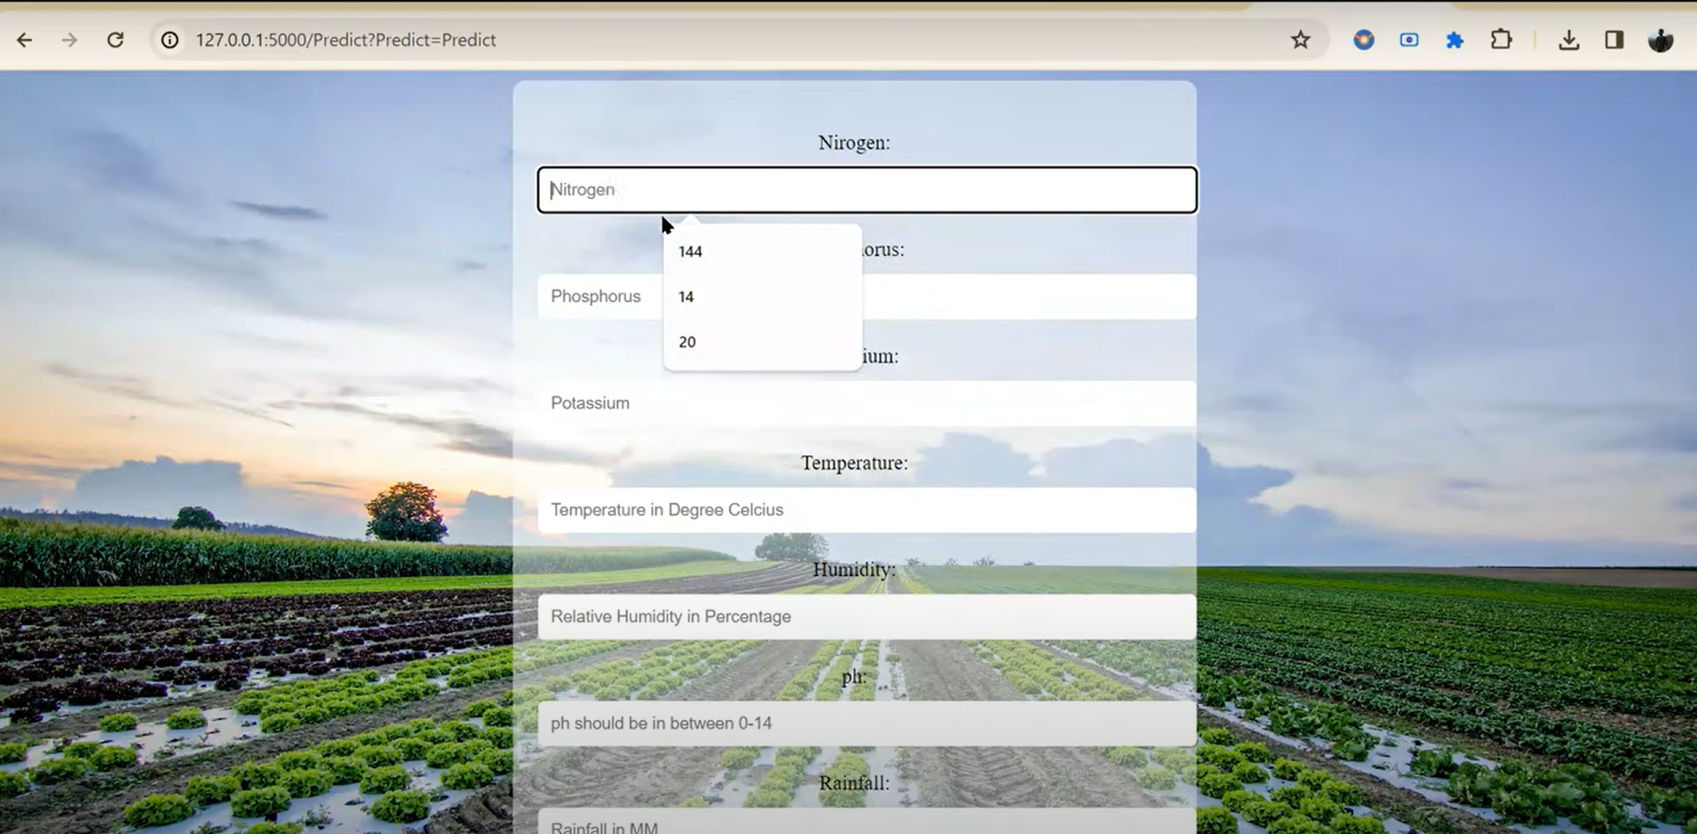
Demo

Slide 11
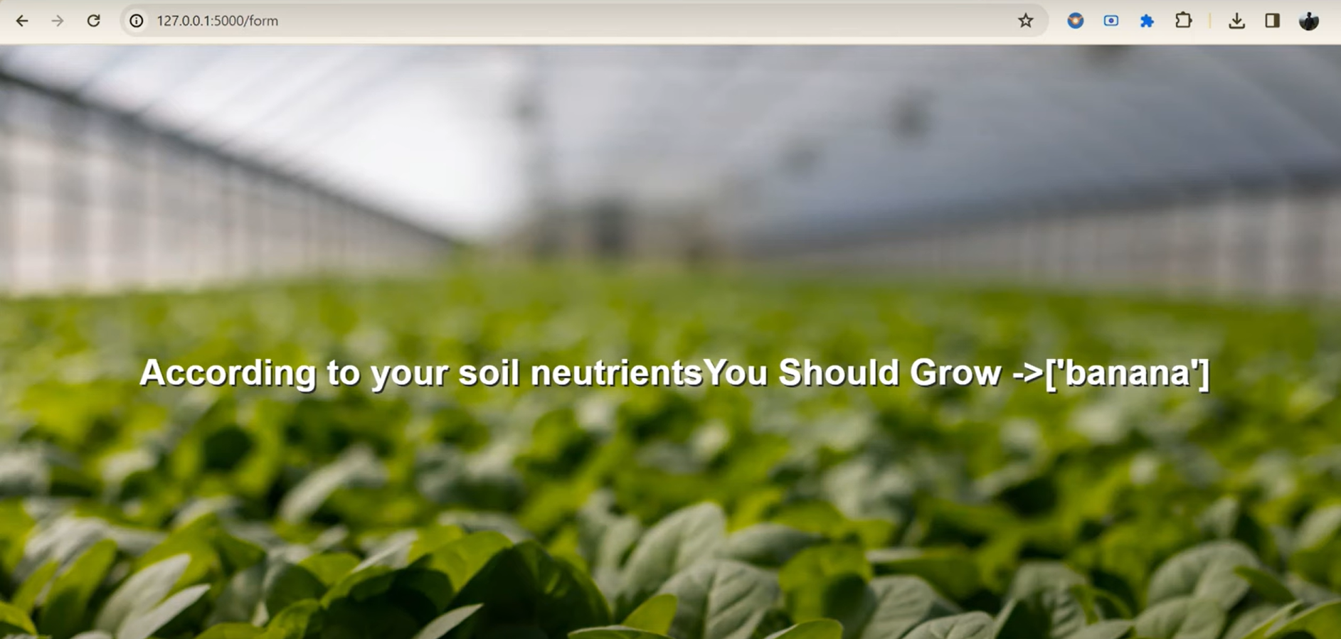
Demo

Slide 12
Thank you

